Slide 1


Radoslav Nikolov
Borislav Borisov
Stamen Ivanov
Victoria Lambova
TAIPEI
TEAM

Slide 2

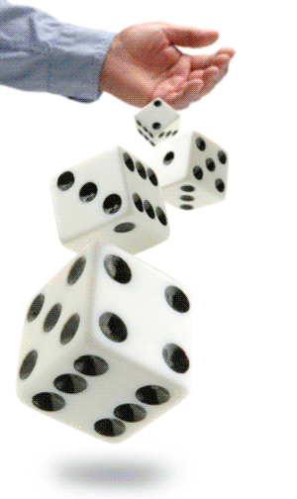
Game Logic
Step1: When both players has already enterred their name
and the budget available they want to pledge with in every step,
they are ready to start playing.
Step2: Through the game
players should roll the dices by pushing the button "Throw".
Dice are used to determine the outcome of events -
the reduction of money amounts .
The game determine it's results as summing the dice's points.
Due to circumstances one of the players looses money
(the budget he had set).
Step3: The game continues until any of the players loses
all of his money. When his budget available is null,
the other one wins.
DICE OR

Slide 3



Tracking Tools
Trello
GitHub

Slide 4
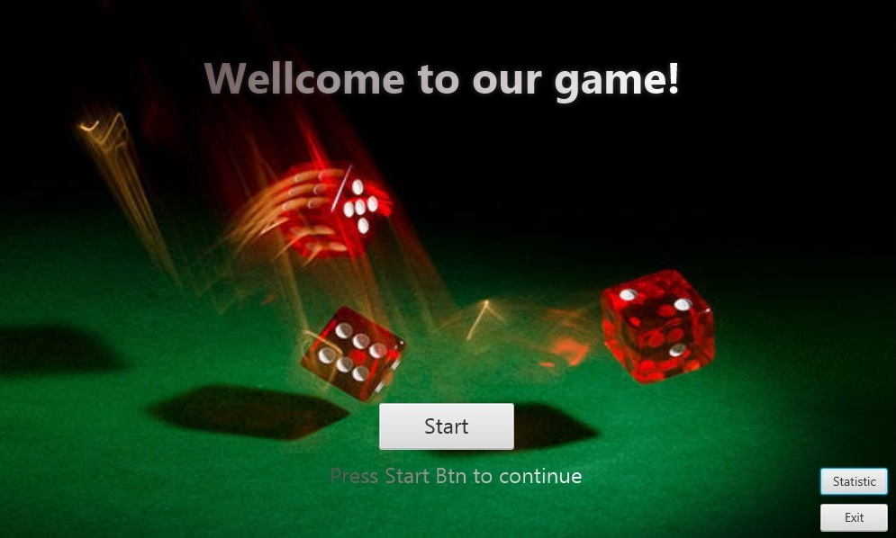

Slide 5
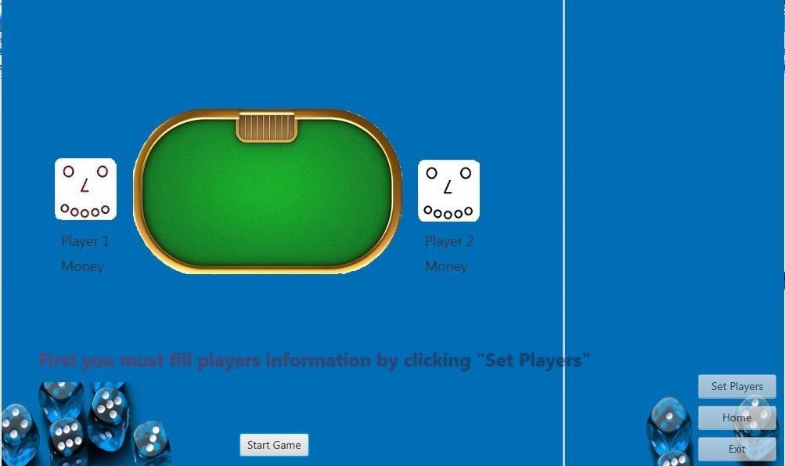

Slide 6
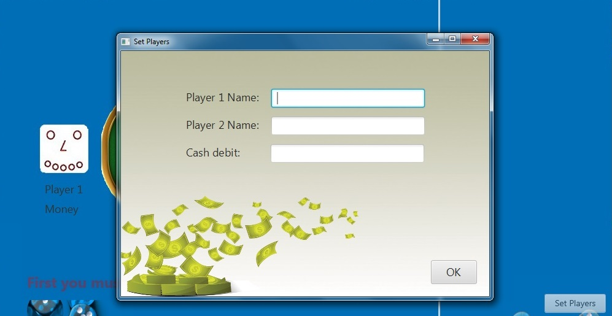

Slide 7
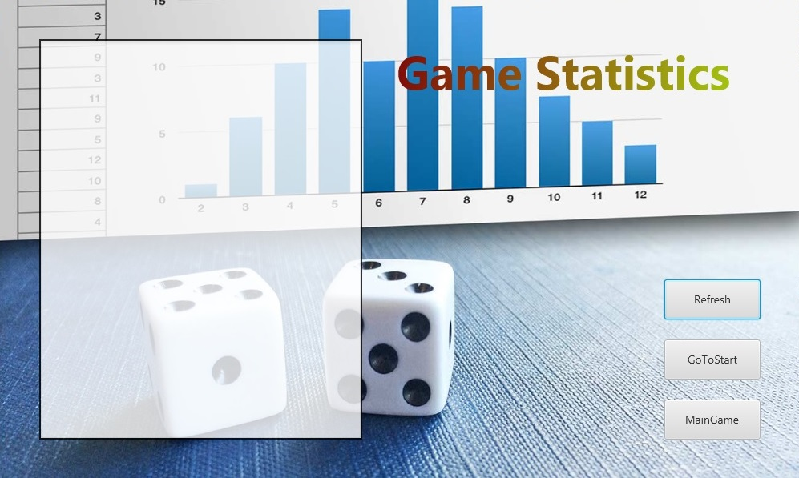

Slide 8

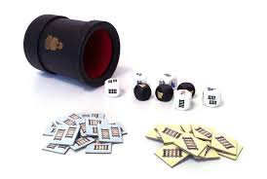
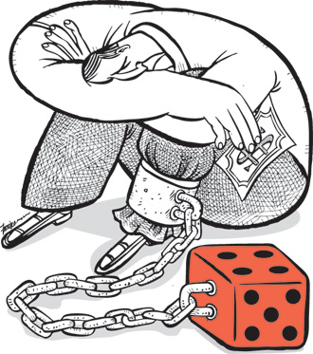
QUESTIONS?

